Slide 1
fMRI Biomarker for Deep Brain Stimulation
Trent Jerde

Slide 2
Parkinson’s Disease
Chronic and progressive movement disorder.
Nearly 1 million people in the US are living with Parkinson's disease.
Cause unknown, and no cure.
Manage symptoms:
Medication
Surgery

Slide 3
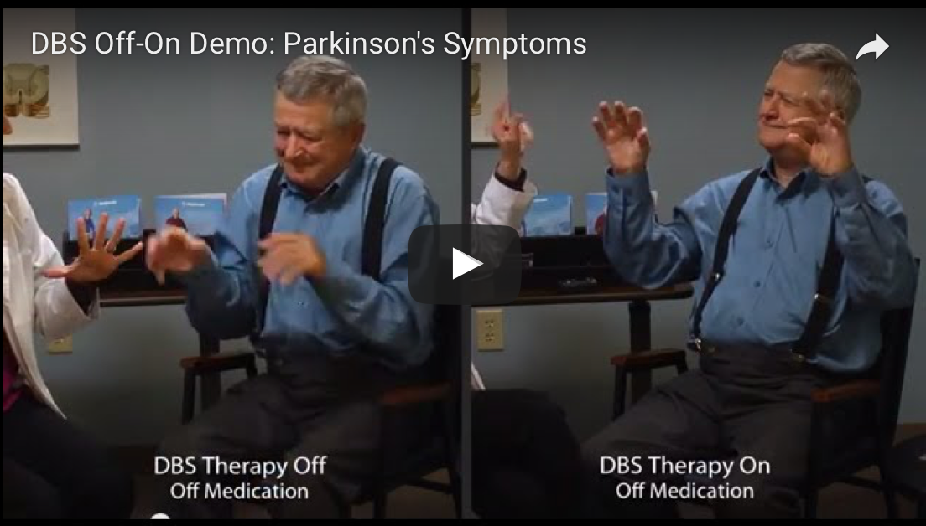

Slide 4
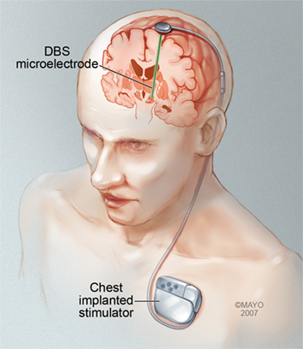
Deep Brain Stimulation (DBS)
The therapeutic mechanisms of DBS are not well understood.
Objective biomarkers for guiding DBS lead targeting and stimulation programming are lacking.

Slide 5
Research Questions
Do different DBS settings evoke unique activation patterns in the brain areas controlling movement?
Electrode stimulation site.
Voltage.
If so, can fMRI potentially be used as a brain biomarker at the time of DBS implantation to optimize therapy for individual patients?

Slide 6
Experimental Design
Electrode Stimulation Sites
3 subjects.
Voltages (V): 1, 3, 5, 7.
Electrode stimulation sites: deep, middle, superficial.
Combinations:
Subject 1, stimulation site deep, 3V.
8 runs per combination.
Superficial
Middle
Deep
RUN 1
ON
OFF
ON
OFF
ON
OFF
RUN 2
ON
OFF
ON
OFF
ON
OFF
RUN 3
ON
OFF
ON
OFF
ON
OFF
RUN 4
ON
OFF
ON
OFF
ON
OFF
RUN 5
ON
OFF
ON
OFF
ON
OFF
RUN 6
ON
OFF
ON
OFF
ON
OFF
RUN 7
ON
OFF
ON
OFF
ON
OFF
RUN 8
ON
OFF
ON
OFF
ON
OFF

Slide 7
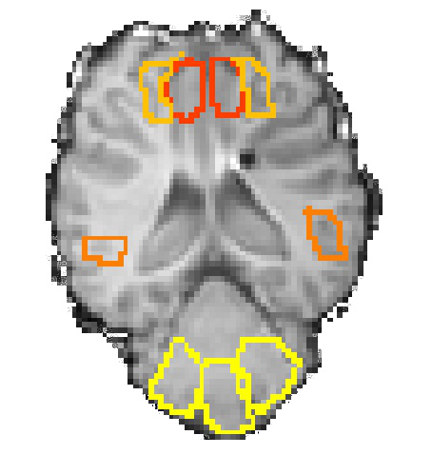
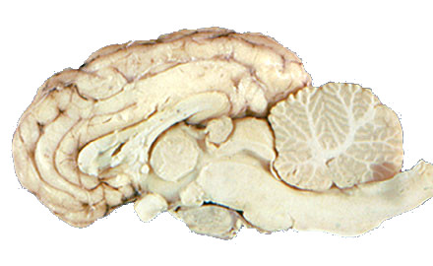
Brain Areas of Interest
Left motor cortex, right motor cortex
Left cerebellum, right cerebellum
M1
STN
Cerebellum

Slide 8
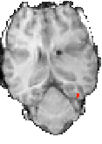
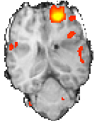
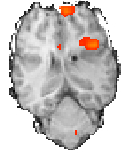


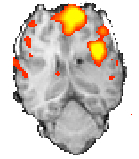
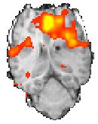

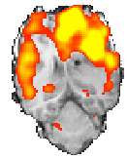
Activation Maps for Voltage Levels for One Subject
Deep
Middle
Superficial
1V
3V
3V
Superficial
3V
5V
5V
Middle
Deep
5V
7V
7V

Slide 16
Summary
Question 1: Do different DBS settings evoke unique activation patterns in the brain areas controlling movement?
Yes.
Question 2: Can fMRI potentially be used as a brain biomarker at the time of DBS implantation to help select optimal settings?
Yes.

